Slide 1

Used Car Prices Prediction
Four Week Data Science Bootcamp
Final Porject. Turki Mohammad aljuhani

Slide 2
Q
How To Predicting Used Car Price ? Determining whether the listed price of a used car is a challenging task, for many factors that drive a used vehicle’s price on the market. The focus of this project is developing machine learning models that can accurately predict the price of a used car based on its features.

Slide 3
Data cleaning
Second Step Check The Data And see the column’s and what is The datatype and missing value
Make | Type | Year | Origin | Color | Options | Engine_Size | Fuel_Type | Gear_Type | Condition | Mileage | Region | Price | Negotiable
0 | Chrysler | C300 | 2018 | Saudi | Black | Full | 5.7 | Gas | Automatic | Used | 103000 | Riyadh | 114000 | False
1 | Nissan | Patrol | 2016 | Saudi | White | Full | 4.8 | Gas | Automatic | Used | 5448 | Riyadh | Negotiable | True
2 | Nissan | Sunny | 2019 | Saudi | Silver | Standard | 1.5 | Gas | Automatic | Used | 72418 | Riyadh | 27500 | False
3 | Hyundai | Elantra | 2019 | Saudi | Grey | Standard | 1.6 | Gas | Automatic | Used | 114154 | Riyadh | 43000 | False
4 | Hyundai | Elantra | 2019 | Saudi | Silver | Semi Full | 2.0 | Gas | Automatic | Used | 41912 | Riyadh | 59500 | False
... | ... | ... | ... | ... | ... | ... | ... | ... | ... | ... | ... | ... | ... | ...
8243 | Audi | A6 | 2015 | Saudi | Silver | Full | NaN | Gas | Automatic | Used | 77000 | Riyadh | 75000 | False
8244 | Chevrolet | Camaro | 2010 | Saudi | Silver | Full | NaN | Gas | Automatic | Used | 150000 | Riyadh | 53000 | False
8245 | Toyota | Land Cruiser | 2013 | Gulf Arabic | White | Full | NaN | Gas | Automatic | Used | 260 | Najran | Negotiable | True
8246 | Nissan | Altima | 2011 | Saudi | Silver | Full | 2.5 | Gas | Automatic | Used | 18500 | Aseer | 22000 | False
8247 | Cadillac | Other | 2013 | Saudi | White | Full | 3.6 | Gas | Automatic | Used | 256000 | Al-Medina | 40000 | False

Slide 4
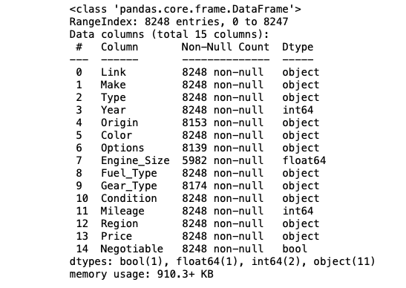
df.info()

Slide 5
Data After Clean
In [22]:
Make | Type | Year | Origin | Color | Options | Engine_Size | Fuel_Type | Gear_Type | Condition | Mileage | Region | Price | Negotiable
0 | Chrysler | C300 | 2018 | Saudi | Black | 0 | 5.7 | 0 | 0 | Used | 103000.0 | Riyadh | 114000.0 | False
2 | Nissan | Sunny | 2019 | Saudi | Silver | 2 | 1.5 | 0 | 0 | Used | 72418.0 | Riyadh | 27500.0 | False
3 | Hyundai | Elantra | 2019 | Saudi | Grey | 2 | 1.6 | 0 | 0 | Used | 114154.0 | Riyadh | 43000.0 | False
4 | Hyundai | Elantra | 2019 | Saudi | Silver | 1 | 2.0 | 0 | 0 | Used | 41912.0 | Riyadh | 59500.0 | False
5 | Honda | Accord | 2018 | Saudi | Navy | 0 | 1.5 | 0 | 0 | Used | 39000.0 | Riyadh | 72000.0 | False

Slide 6
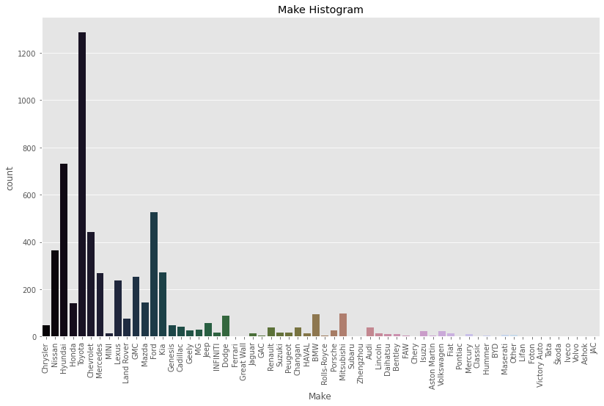
Through the graph, we see that Toyota cars are among the most sold cars, followed by Hyundai and Nissan

Slide 7
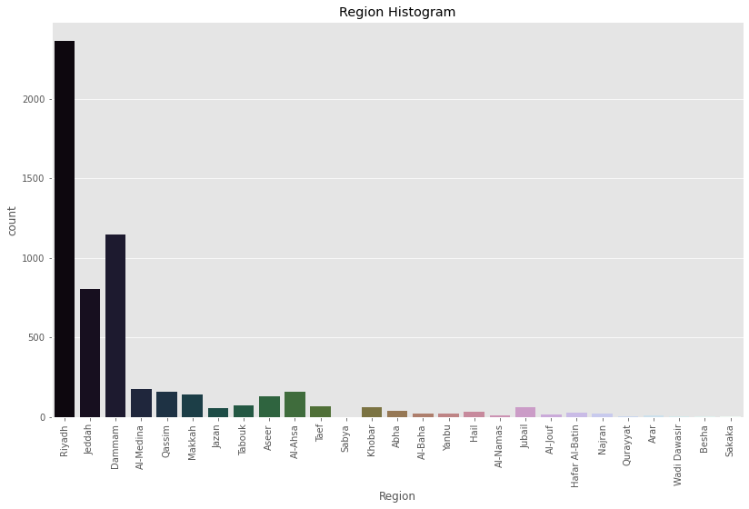
Through the graph of the regions, we note that most of the cars sold are in the Riyadh region

Slide 8
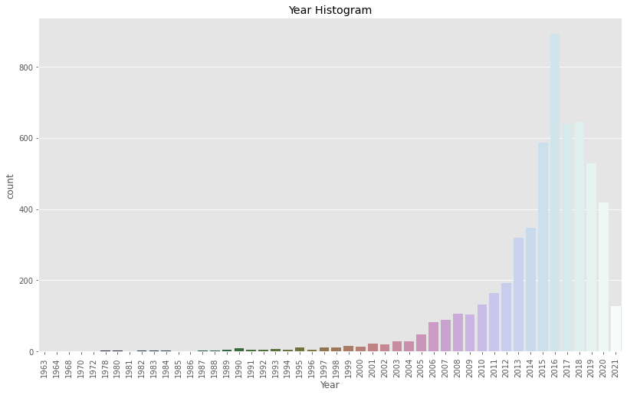
Through the graph of the Year , we note that most of the cars sold are 2018 , 2017 ,2016 modals

Slide 9
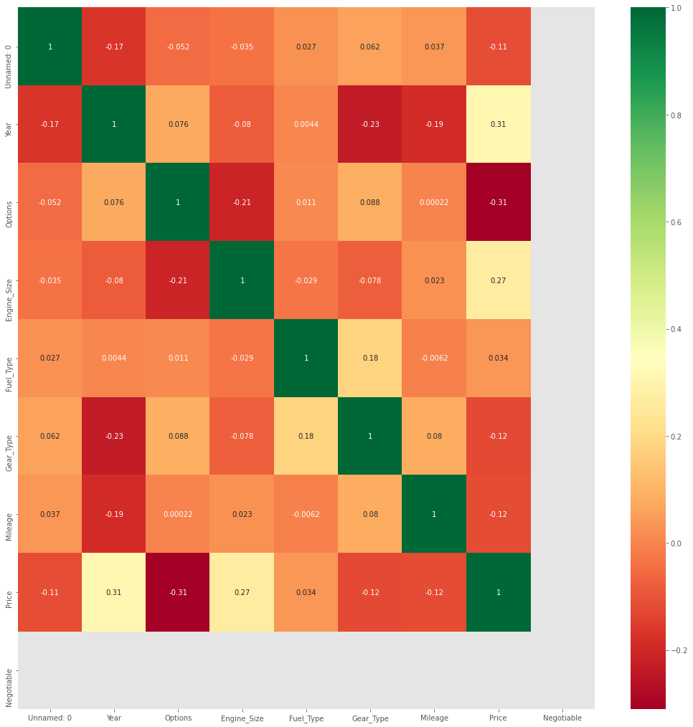

Slide 10
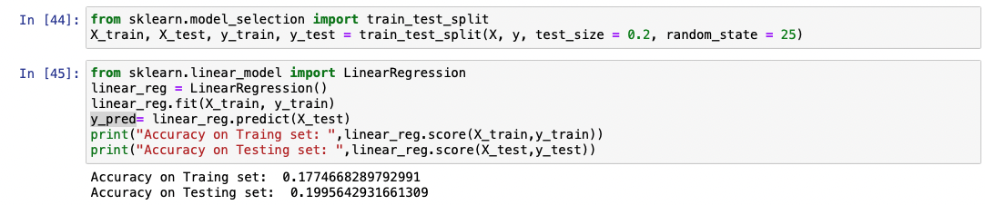
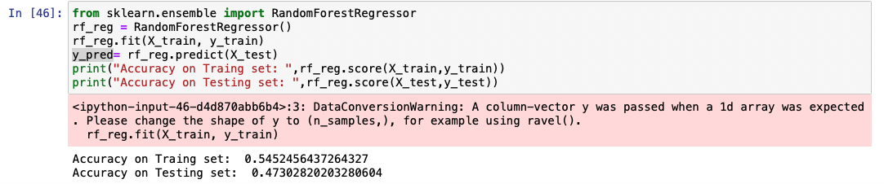

Slide 11
Through what I learned in the camp about how to deal with data, and I cleaned and presented the data, I tried to put a number of questions, but through the presentation of the data, some questions were answered. I think that through more research and self-learning, I will deal in the future with many The data that will enable me to develop in this field

